Slide 1
”The situation”
DENMARK

Slide 2
Asylum seekers 2013-2016
2013: 7.557
2014: 14.792
2015: 21.316 646 denied
2016: 5.976 434 denied

Slide 3
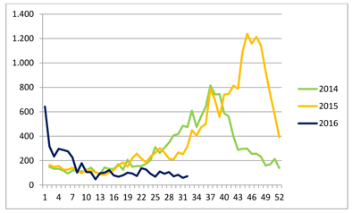
Numbers per week in Denmark

Slide 4
Family reunification
2013: 7.215
2014: 12.307
2015: 16.017
2016: 8.094

Slide 5
Where do they come from? Top 5
2013 Syria 2.010 Russia 982 Somalia 965 Serbia 466 Afghanistan 426 | 2014 Syria 7.210 Eritrea 2.275 Stateless 1.140 Somalia 700 Russia 520 | 2015 Syria 8.608 Iran 2.787 Afghanistan 2.331 Eritrea 1.740 Stateless 1.734 | 2016 Syria 20% Afghanistan 19% Stateless 8% Irak 7% Marokko 5%

